Slide 1


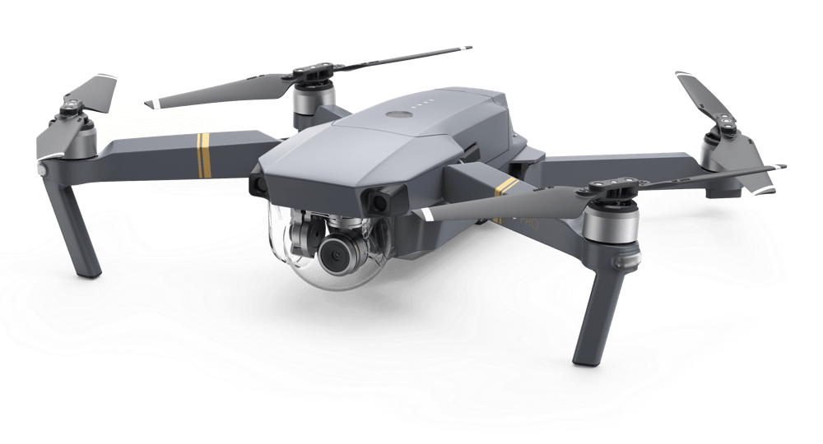
Unmanned Aerial Vehicle (UAV)

Slide 2
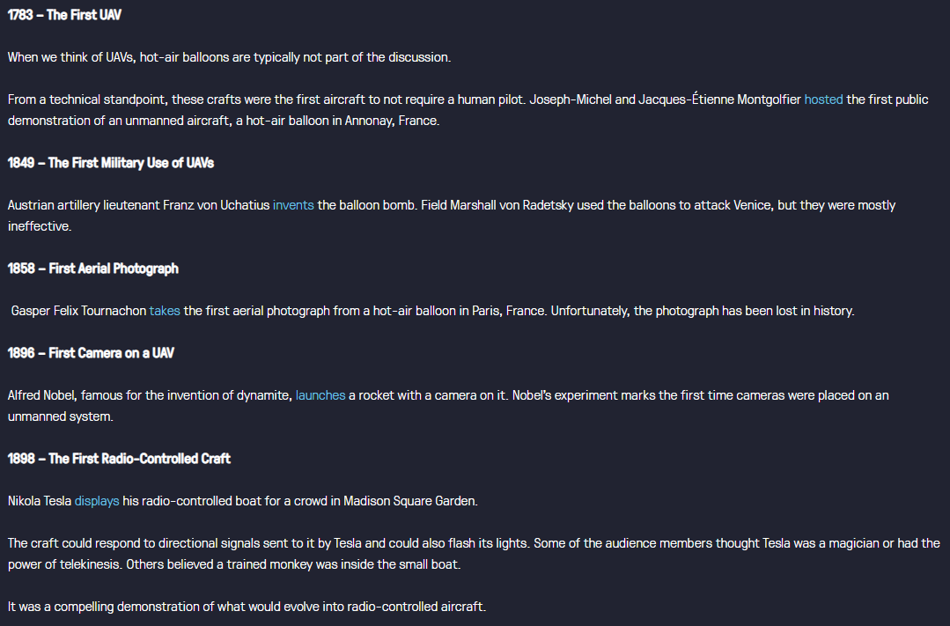
History of the UAV robot

Slide 3
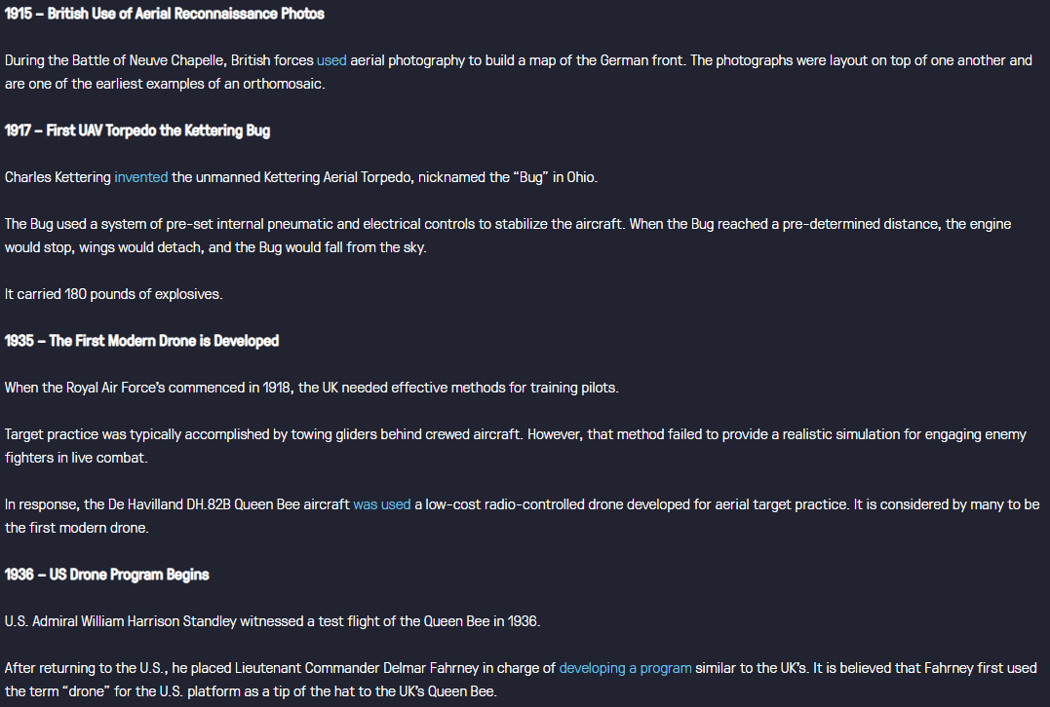
History of the UAV robot

Slide 4
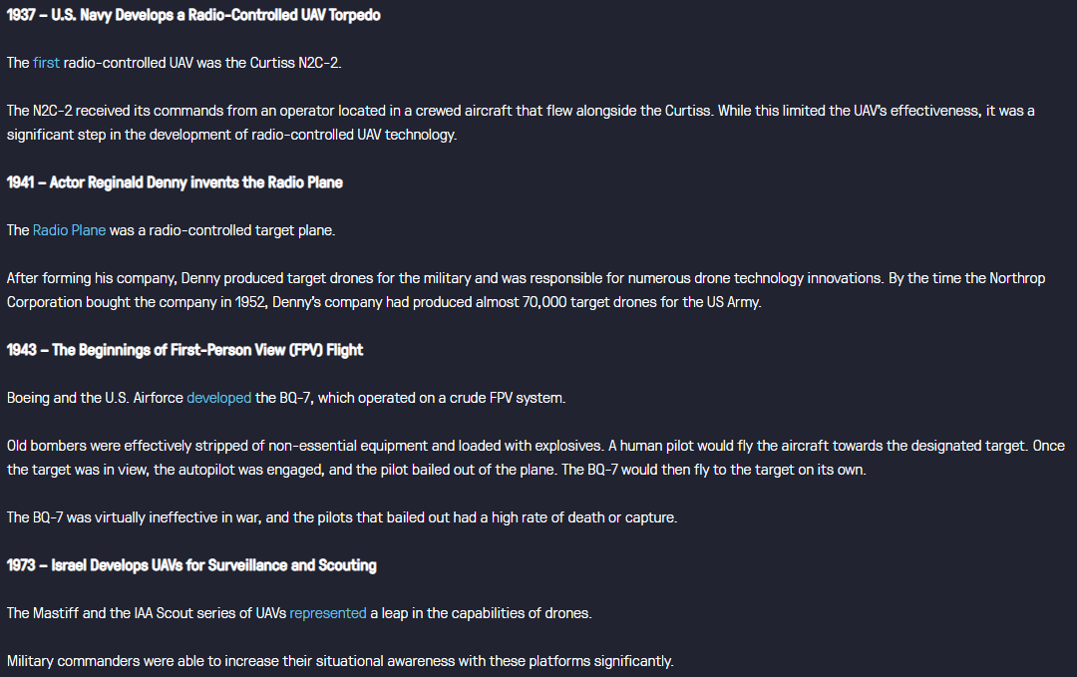
History of the UAV robot

Slide 5
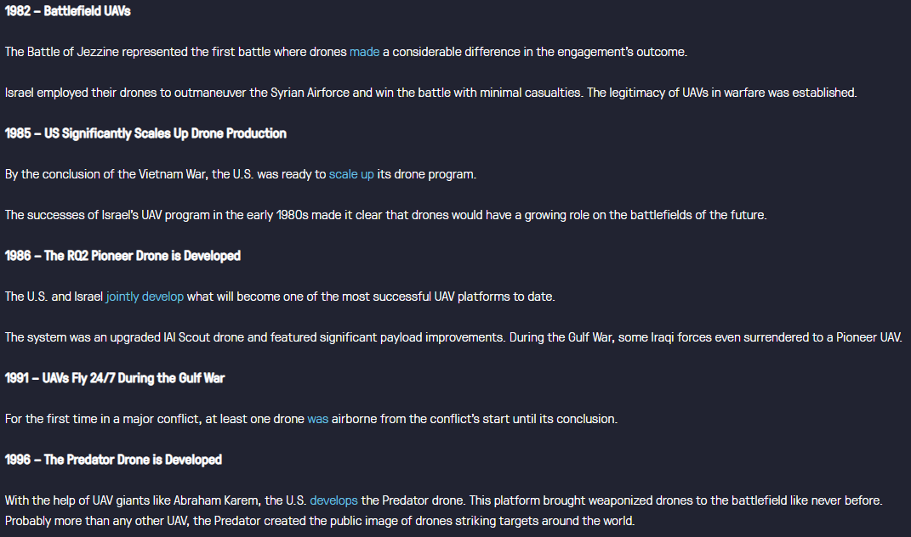
History of the UAV robot

Slide 6
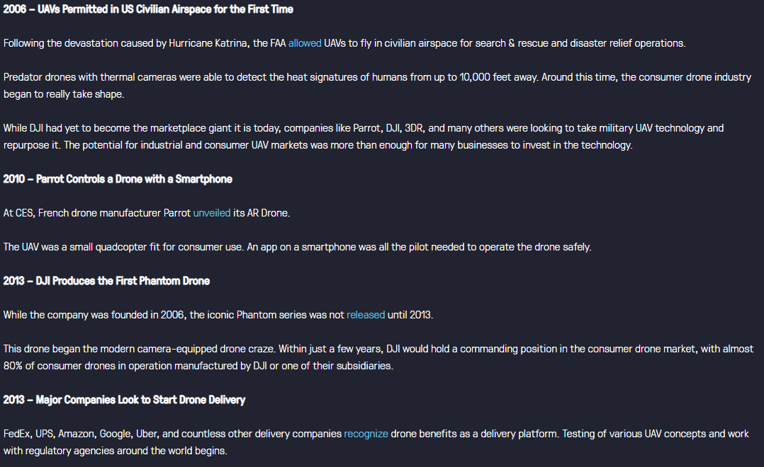
History of the UAV robot

Slide 7
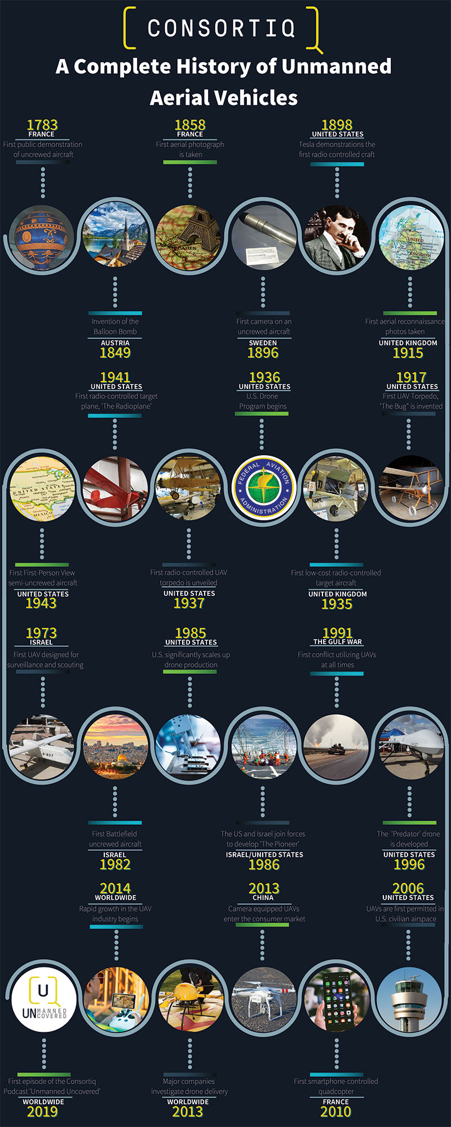
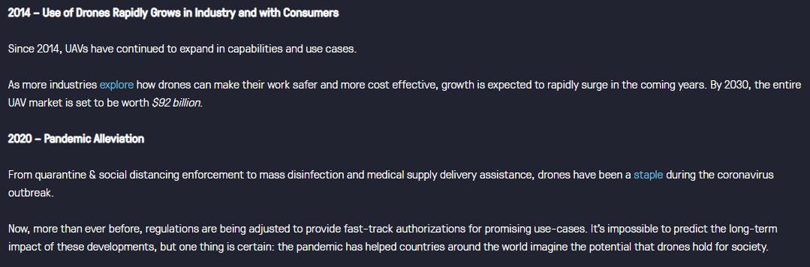
History of the UAV robot

Slide 8
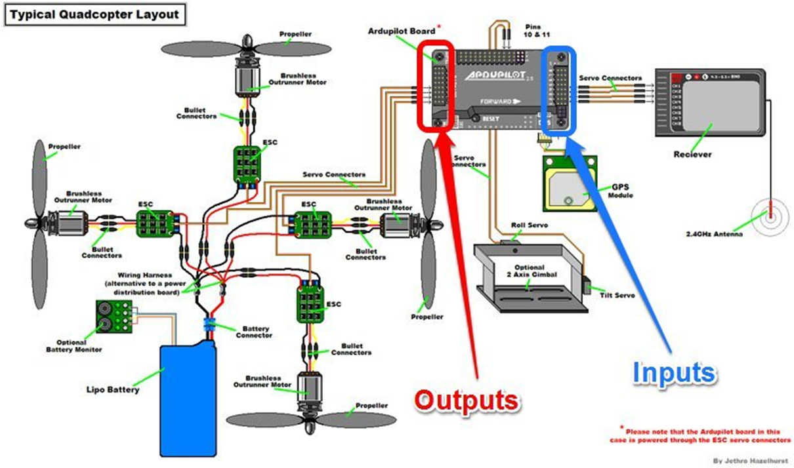
Basic system architecture

Slide 9
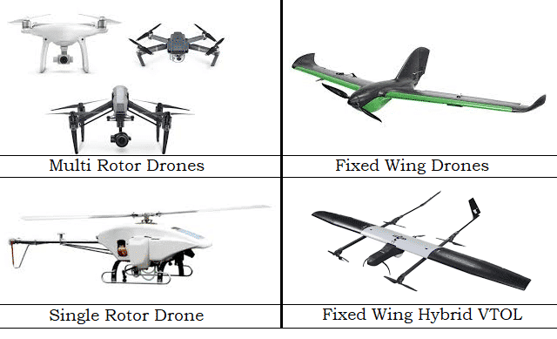
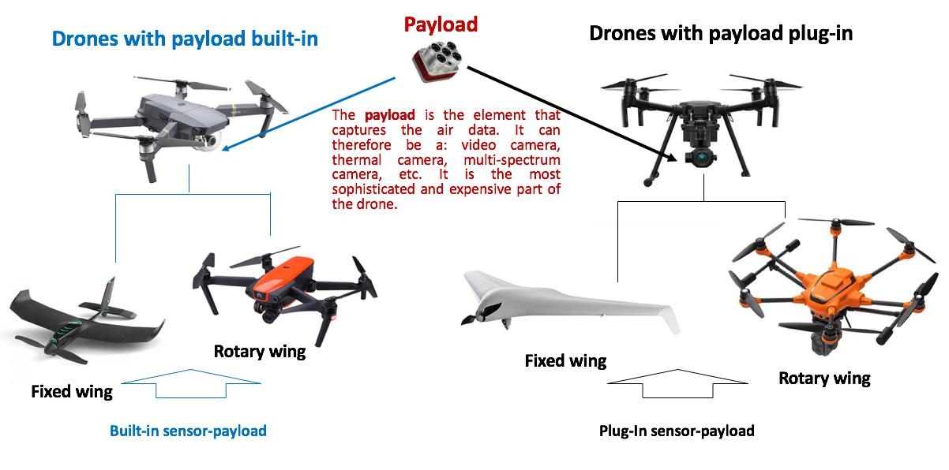
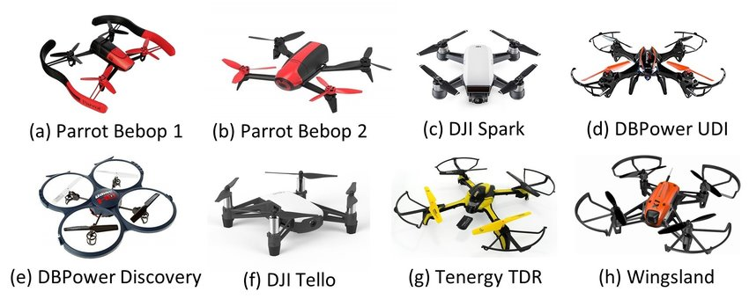
1) ROBOT DESIGN

Slide 10
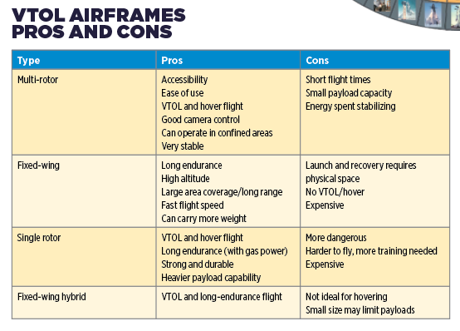
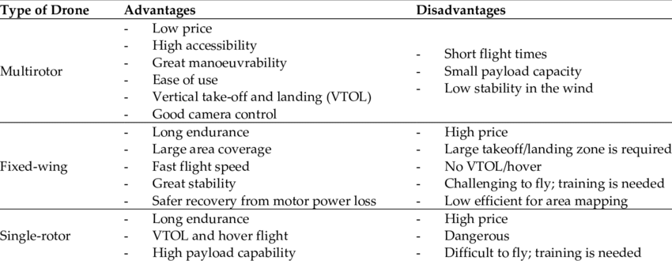
1) ROBOT DESIGN

Slide 11
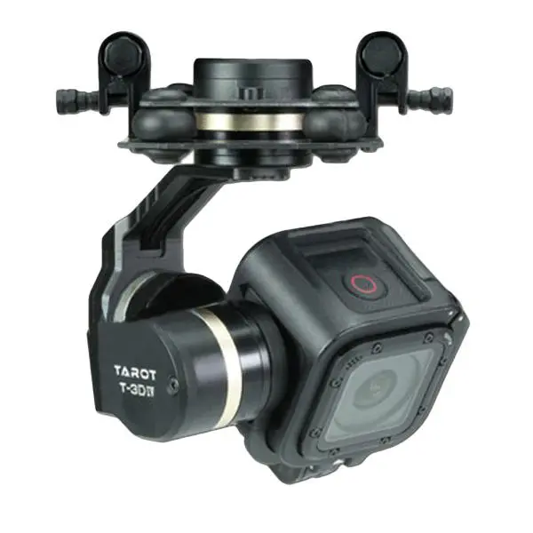
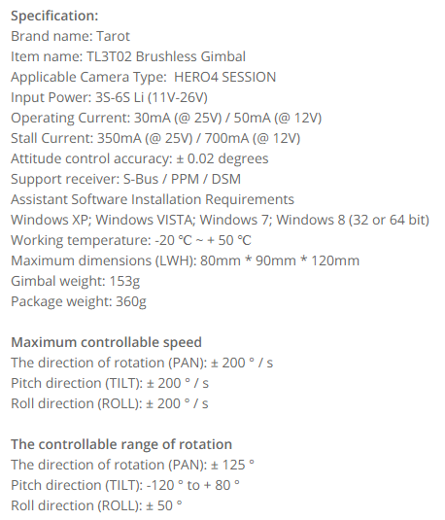
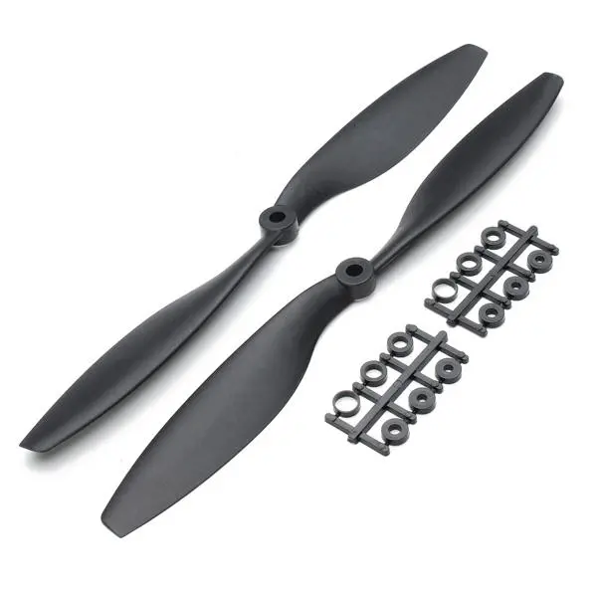
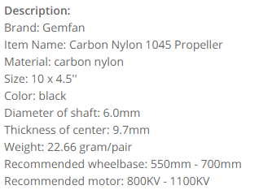
2) Actuators and locomotion
GIMBLE
Remote sensing
Agriculture
Light show
Transporter
PROPELLER

Slide 12
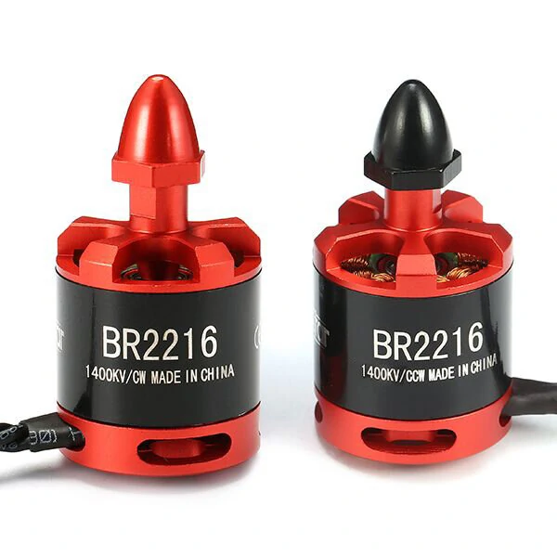
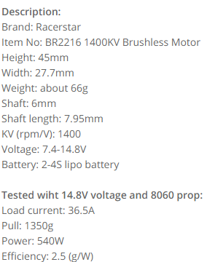
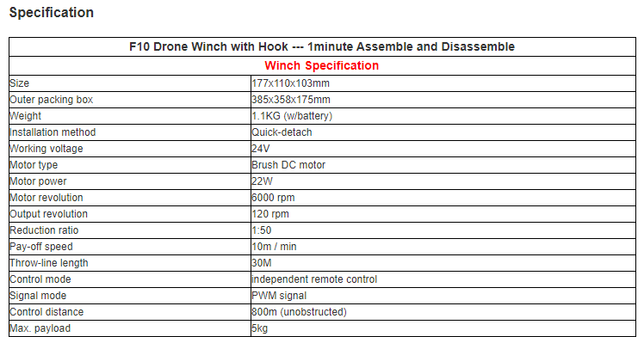
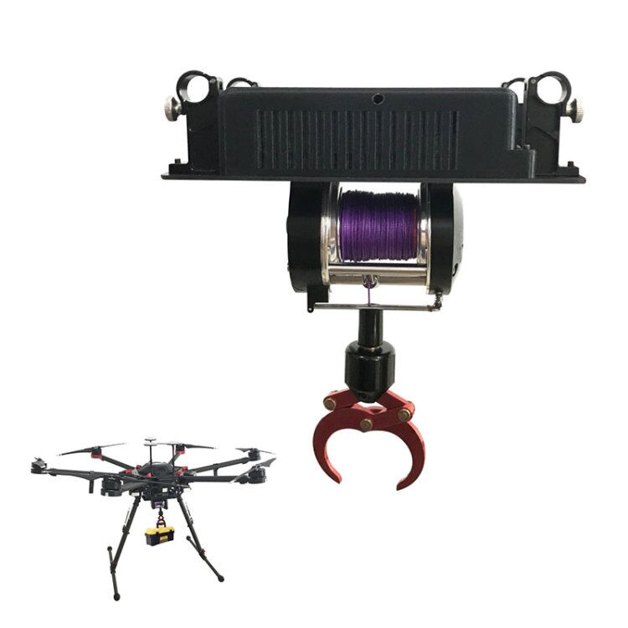
2) Actuators and locomotion
BRUSHLESS
MOTOR
Remote sensing
Agriculture
Light show
Transporter
WINCH

Slide 13
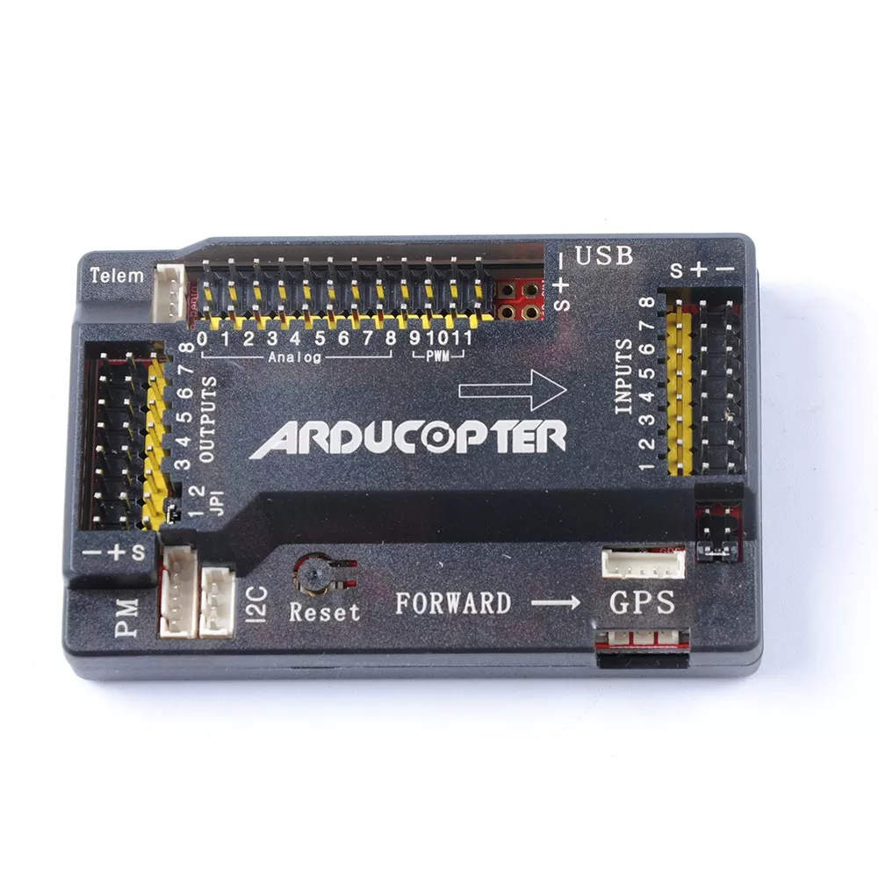
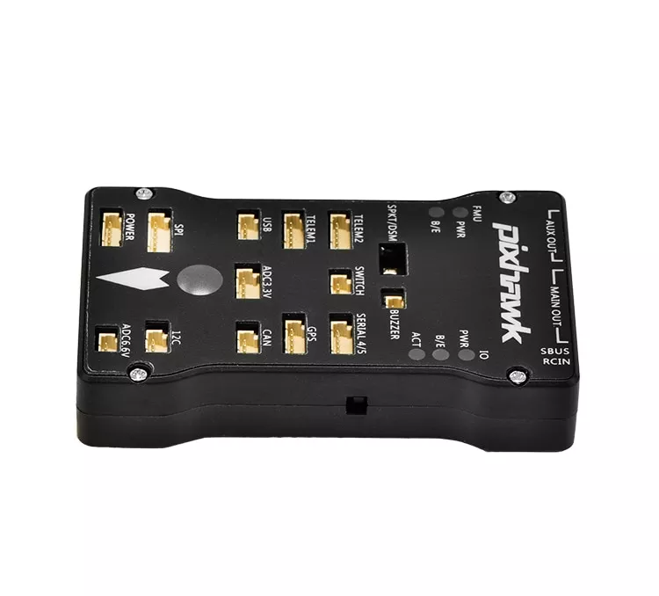
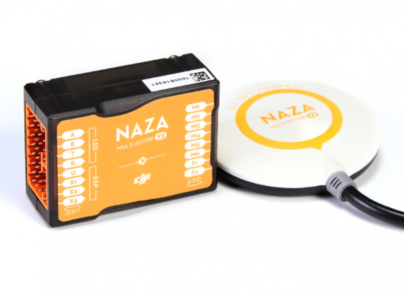
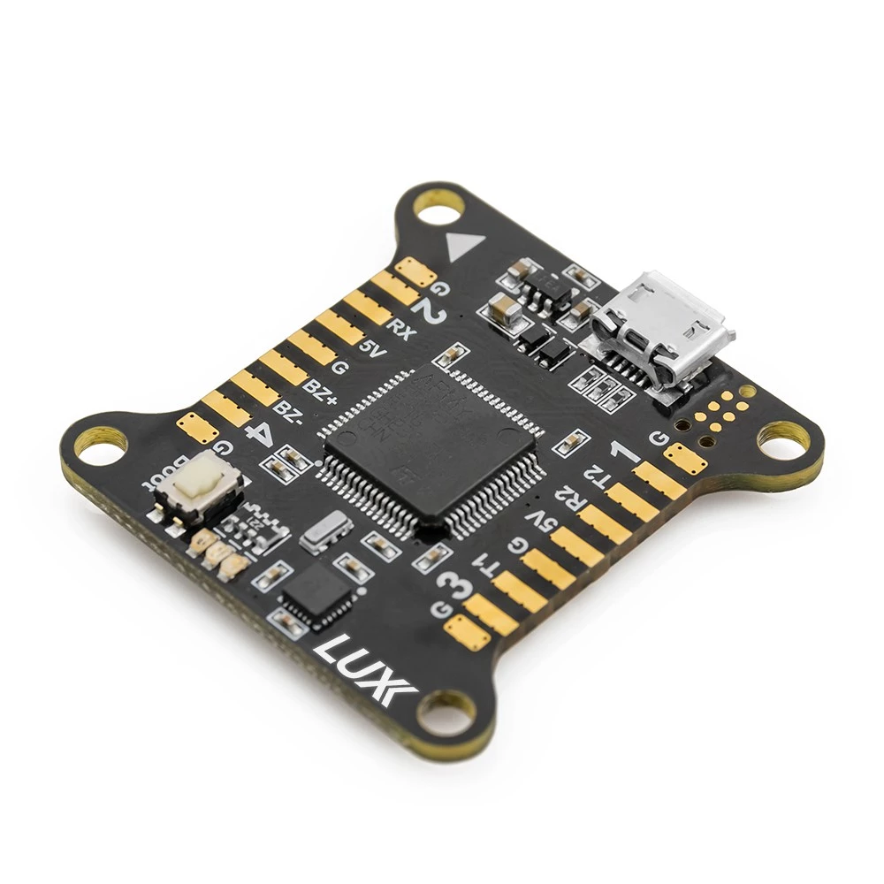
3) Navigation system and controller
ARDUPILOT
PIXHAWK
DJI NAZA
RACER

Slide 14
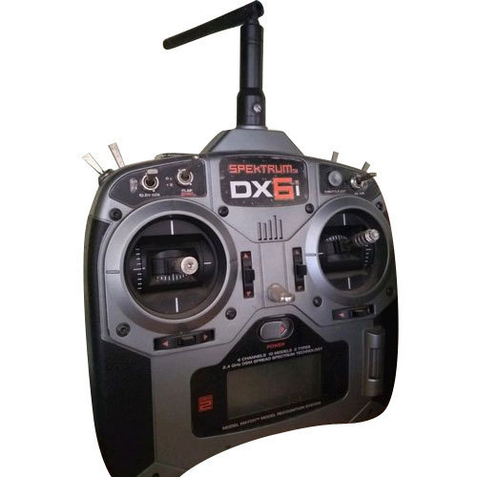
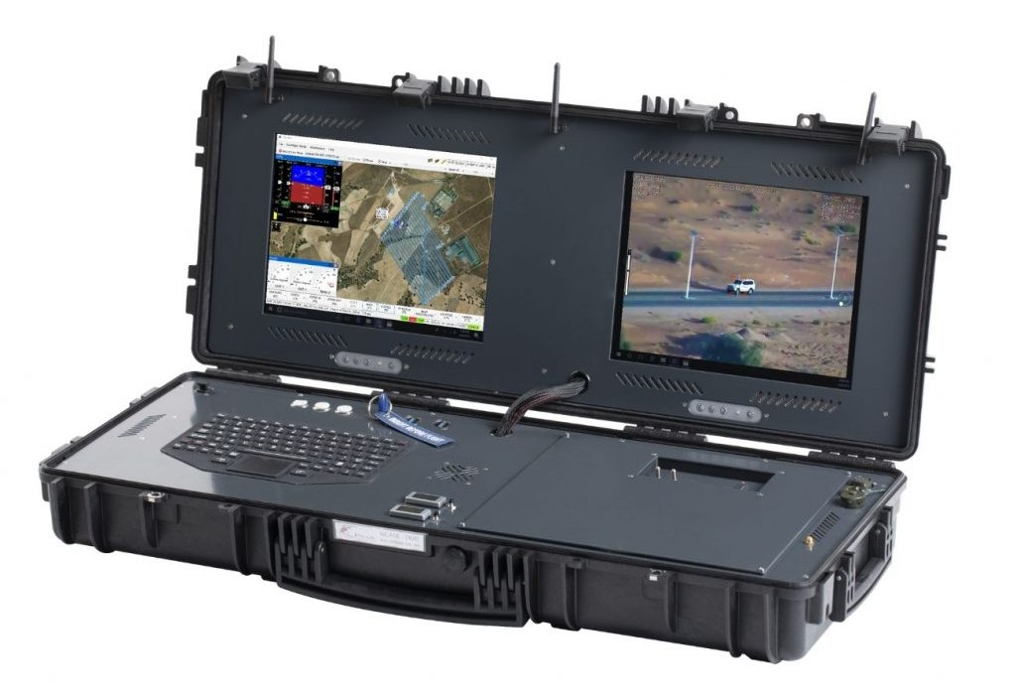
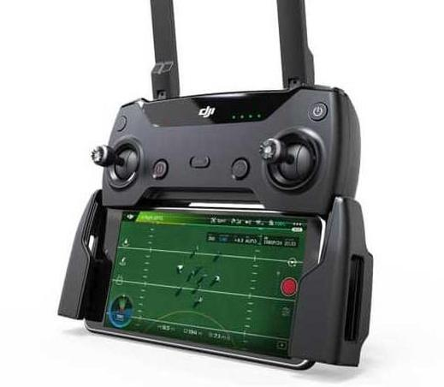
3) Navigation system and controller
RC REMOTE CONTROLLER
GROUND CONTROL STATION
PHONE REMOTE CONTROLLER

Slide 15
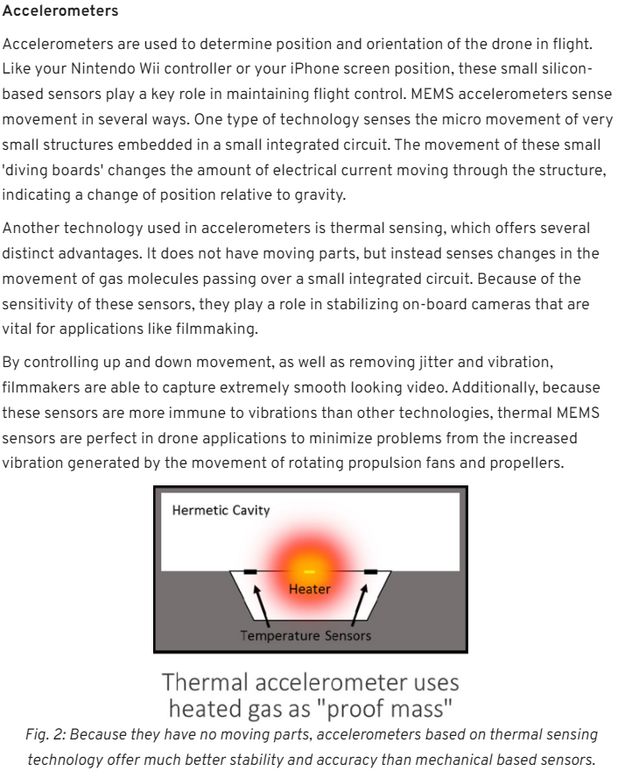
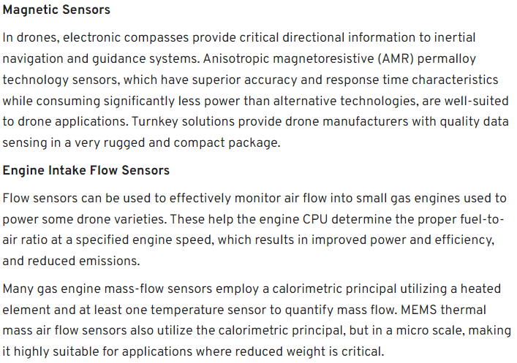
3) Navigation system and controller

Slide 16
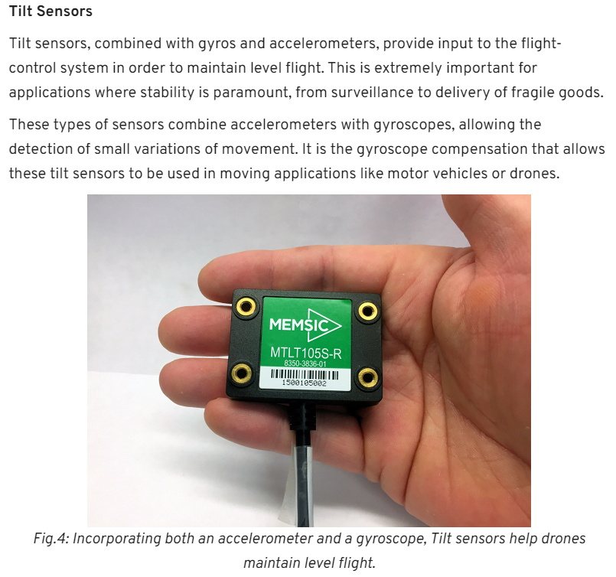
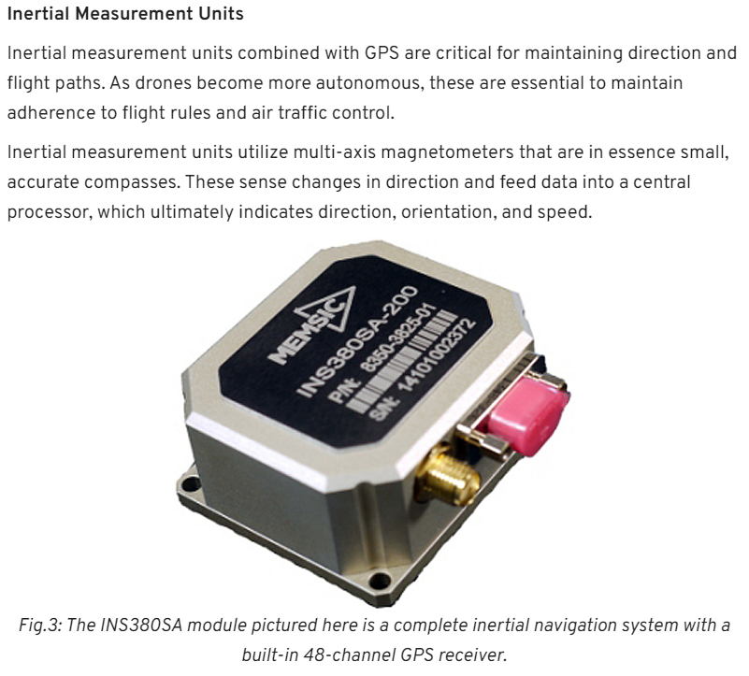
3) Navigation system and controller

Slide 17
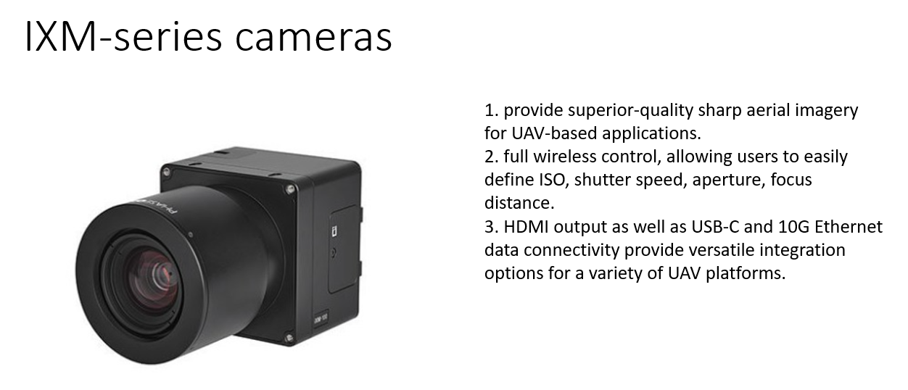
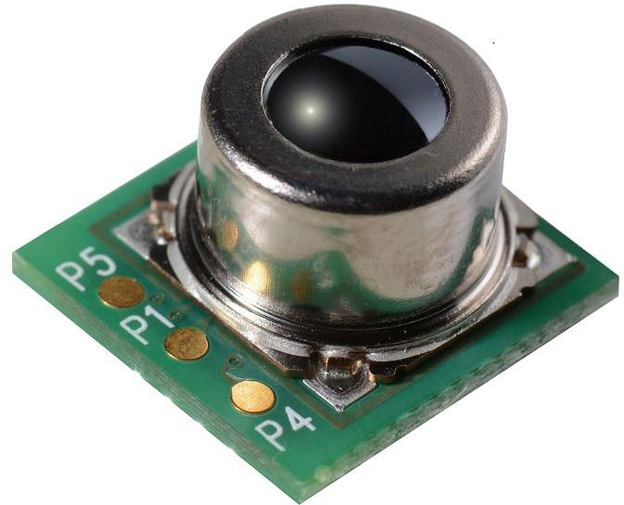
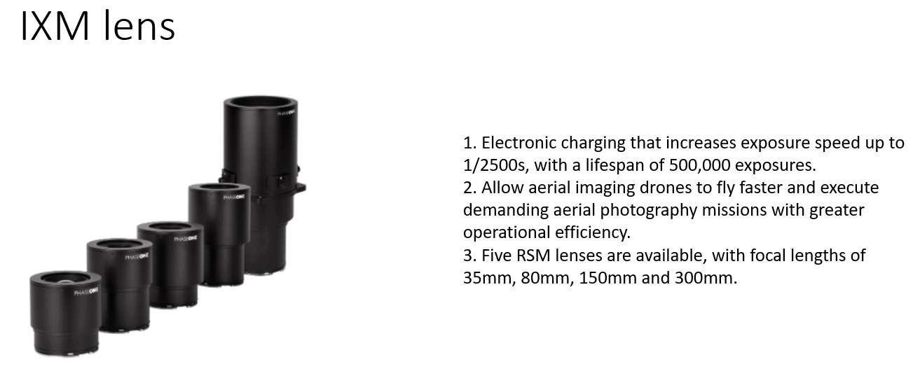
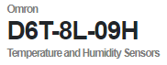
4) DATA COLLECTION
CAMERA
HUMIDITY & TEMPERATURE SENSOR

Slide 18
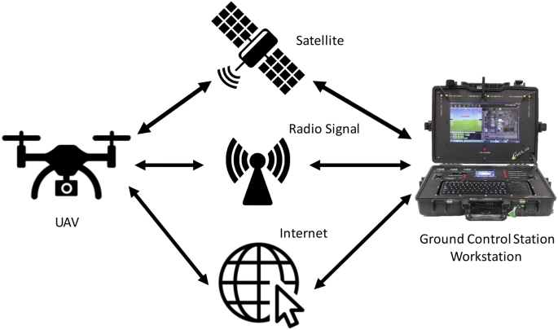
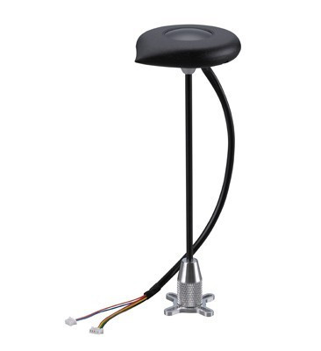
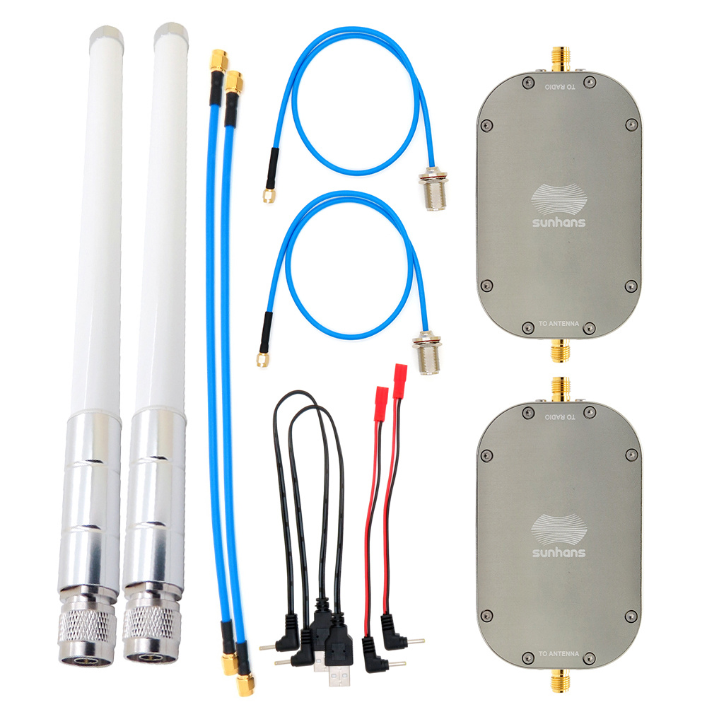
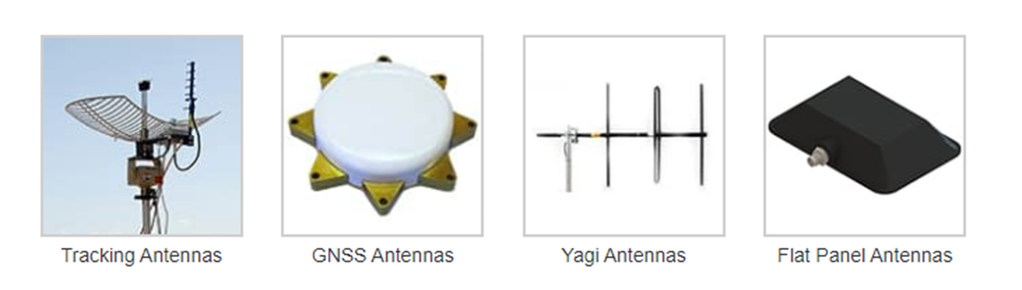
5) Data transmission
Antennas are used for data recording and transmission and avionic functions.
Allow information transmission to other systems and people on ground.
Ground-to-ground, Ground-to-air, air-to-ground.
GNSS ANTENNA
WIFI ANTENNA
RC REMOTE CONTROLLER

Slide 19
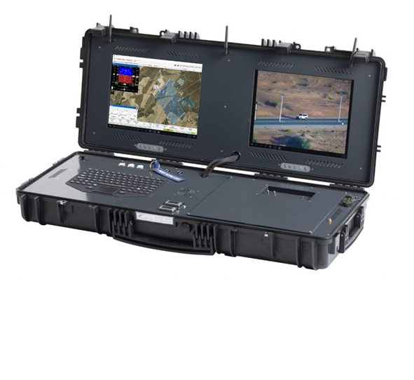
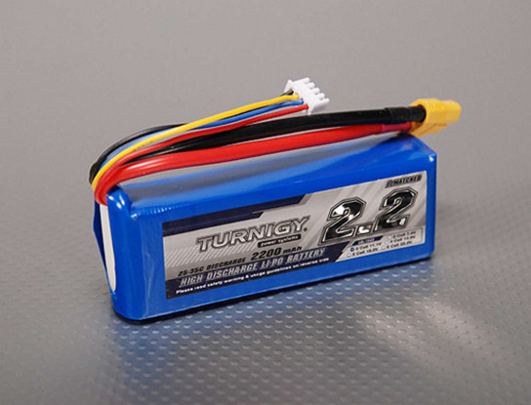
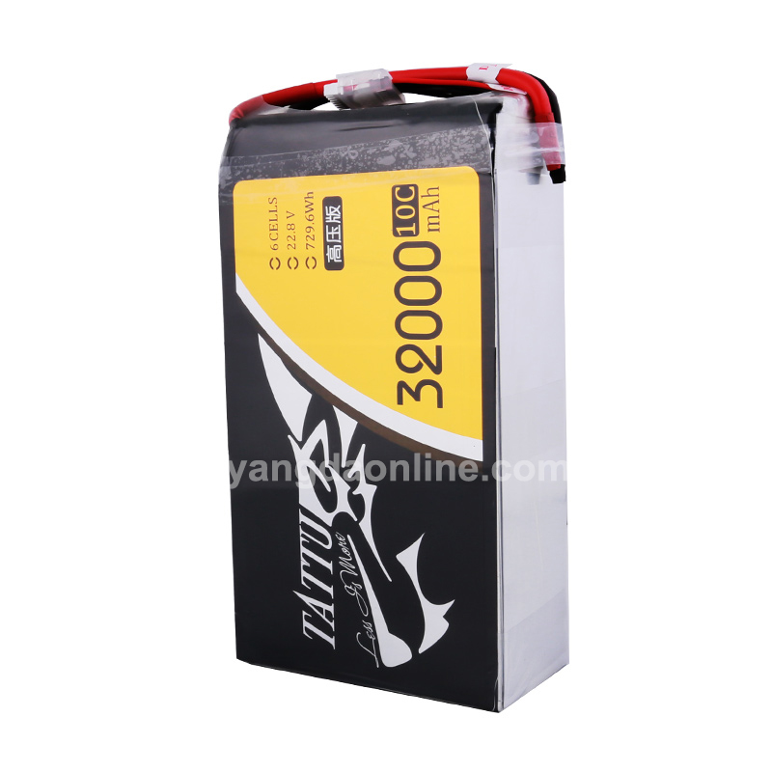
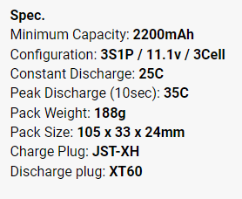
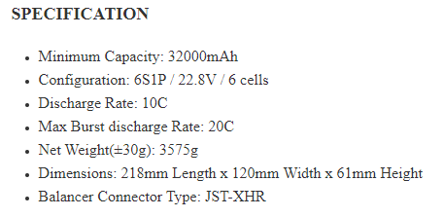
6) Power system management
LITHIUM-ION
BATTERIES

Slide 20
UAV COMPANY IN MALAYSIA
Poladrone - https://www.poladrone.com/
Vortex Edge - http://www.vortex-edge.com/
Aerodyne - https://aerodyne.group/
Avetics - https://www.avetics.com/
Dragonfly Robotix - https://www.dragonflyrobotix.com/
DEFTECH US - https://www.deftechust.com/
Centaurus Technology - https://www.centaurustechnology.com/

